Slide 1

Classify Them All Predicting Pokémon Types with Machine Learning Scott Ratchford

Slide 2



What is a Pokémon?
Pikachu
Notes:
Pokémon are fictional creatures from a video game series of the same name. There are over 1,000 Pokémon species. This one is called Pikachu.

Slide 3


















Pokémon Types
Each Pokémon species has exactly 1 or 2 types.
Notes:
Each Pokémon is labeled with exactly 1 or 2 “types” from a list of 18 types. These types have names like Fire, Water, and Grass.

Slide 4
How can we predict Pokémon types?
Notes:
How can we predict Pokémon types?

Slide 5


Charizard
Notes:
Although a Pokémon’s appearance may provide some indication of its type, it is sometimes difficult for a human to identify what type(s) a Pokémon is from appearance alone.
Let’s take Charizard, for example. Charizard has large wings, a flaming tail, and it’s shaped like a traditional Western dragon. Charizard mostly uses warm colors, like orange, further emphasizing its flame.
What type or types do you think Charizard is? (Pause for input.) The wings hint that it’s a Flying type. The tail indicates it could be a Fire type. But what about that dragon-like appearance? Well, Charizard is a Fire and Flying type, but it’s not a dragon.

Slide 6
What data can we use?
Notes:
If we can’t just look at the Pokémon to determine its type, what data can we use to automatically predict types?

Slide 7
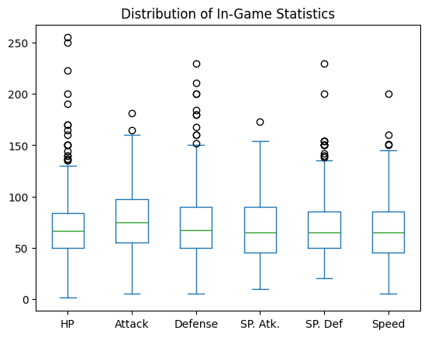


Data Sets
Pokémon Images
Sourced from Pokémon video games
1 image per Pokémon
Transparent backgrounds
In-Game Statistics
Sourced from Pokémon video games
Pikachu
Charizard
Notes:
I’ve used two data sets as a starting point for my analysis. First is a dataset of Pokémon images. Each Pokémon gets one image, taken from one of the Pokémon video games. Each image has a transparent background.
The next data set contains the Pokémon species’ in-game statistics. Each Pokémon has six main numeric attributes, health points, attack, defense, special attack, special defense, and speed. These numbers may range from 1 to 255, and different stats follow different distributions.

Slide 8
Data Preprocessing
Notes:
The next step is data preprocessing.

Slide 9



1. Removed alternate forms of each Pokémon
Charizard
Mega Charizard X
Mega Charizard Y
Notes:
First, I removed alternate forms of Pokémon. Most Pokémon do not have alternate forms, but some do. Including these alternate forms would cause particular Pokémon and types to be further overrepresented in the data sets. Additionally, there would be quite a bit of difficulty in combining the data sets due to their ways that their values were stored.
Charizard has alternate forms, including Mega Charizard X and Mega Charizard Y. I kept the normal Charizard but removed his variants.

Slide 10
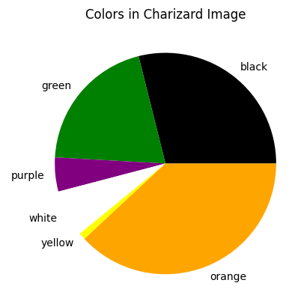
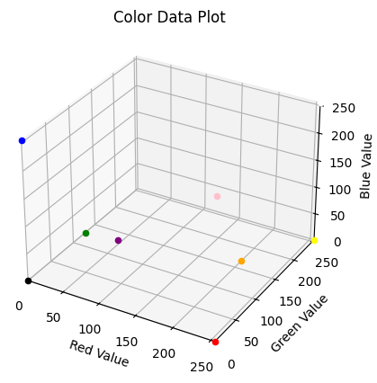
2. Quantified colors in each image
Charizard
Notes:
Next, I quantified colors in each image. In the image dataset, each pixel is defined with a red, green, and blue value, also known as RGB. I defined nine colors with RGB values. For each image in the dataset, I calculated the Euclidean distance to each point. Each pixel was known by the color closest to its RGB value. For example, a pixel that is 250 red, 240, green, and 230 blue would be closest to white, increasing the white count for that image. Then, I converted the color counts to percentages.
Charizard’s color percentages are in this pie chart. Charizard is about 35% orange, 30% black, and so on. You’re probably wondering why Charizard is 20% green and 0% blue. That’s because its wings are slightly closer to green than blue by these definitions.
Before using these percentages in the data set, they were also standardized before usage. The outline present on each image is black, so we need to ensure that this feature does not become too impactful in the analysis.

Slide 11
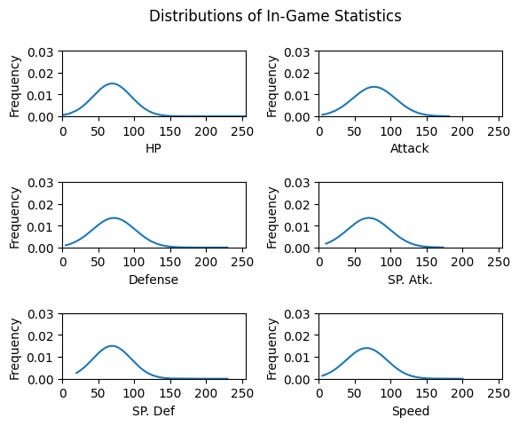
3. Scaled In-Game Statistics
Notes:
I also scaled the in-game statistics. This helped account for the outlying points, especially in health points and defense. Here, you’ll see the frequency of each stat’s value.

Slide 12
4. Train-Test Split
The same Pokémon were used in each training set and each testing set.
Train: 80%
Test: 20%

Slide 13
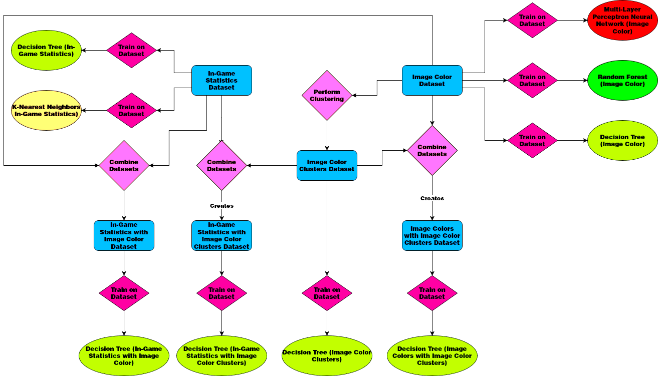
Training Models
Notes:
This is a diagram representing the process I followed. Each model was placed in a multi-label classification wrapper. This means that each time the model made a prediction, it attempted to predict both types of the Pokémon. If it predicted that the Pokémon only had one type, the second type was labeled as “None”.
First, I trained a decision tree and a k-nearest neighbors model on the in-game statistics. Next, I trained a decision tree, a random forest, and a multi-layer perceptron neural network on the image color data. I also performed clustering on the image colors using the K-Means algorithm. I created 8 clusters, because this aligned best with the distribution of colors. I trained a decision tree on just the image color clusters. Finally, I trained decision trees on the combinations of different data sets. These combinations were the in-game statistics and image colors, the in-game statistics and color clusters, and the image colors and the color clusters.

Slide 14
Machine Learning Models
 |  | Accuracy
Data Set(s) Used | Model Type | Either Type | Both Types
In-Game Statistics | K-Nearest Neighbors | 9.90% | 1.04%
In-Game Statistics | Decision Tree | 8.33% | 1.04%
Image Colors | Decision Tree | 12.50% | 0.00%
Image Colors | Random Forest | 7.81% | 0.00%
Image Colors | Multi-layer Perceptron Neural Network | 9.90% | 0.00%
Image Color Clusters | Decision Tree | 53.65% | 8.85%
In-Game Statistics and Image Color Clusters | Decision Tree | 23.44% | 1.04%
Image Colors and Image Color Clusters | Decision Tree | 22.92% | 1.04%
In-Game Statistics and Image Colors | Decision Tree | 28.13% | 0.52%
Notes:
Here’s how each model performed on the test data. “Either-type accuracy” refers to whether at least one of the model’s type predictions was correct. “Both types” refers to whether the model accurately predicted both types.
You can read the data for yourself, but I’d like to highlight a few specifics. First, the models trained on the in-game statistics performed very poorly. These stats have very little, if any, correlation with types. The color data had the same issue.
However, the predictions based on the color clusters were far more successful. Although the clustering algorithm only identified 8 clusters (compared to the 18 overall types that exist), this information was very useful to predictions. Predictions based solely on color clusters were accurate more than half of the time. Augmenting other data sets with the color cluster data drastically improved their performance.

Slide 15
Conclusions
In-game statistics have little to no relevance in type predictions
Color data are more useful when clustered into similar groups
Multi-label classification is significantly more difficult than single-label classification
Further studies could extract more data from images

Slide 16
Thank you
Do you have any questions?

